Slide 1

06 Webinars and Large Meetings

Slide 2

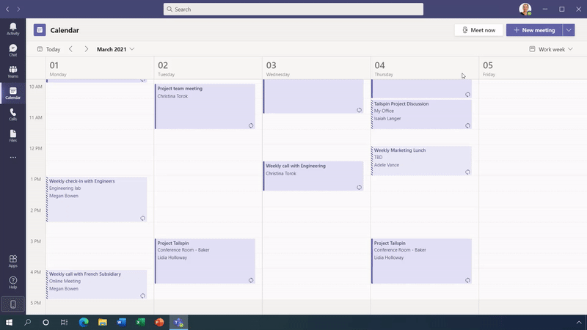
Registration and Confirmation
Easily add a custom attendee registration page to your meeting or webinar to manage attendance before and after any engagement.
Following registration, attendees automatically receive an email confirmation for a simple join experience
Release = H1 CY2021

Slide 3

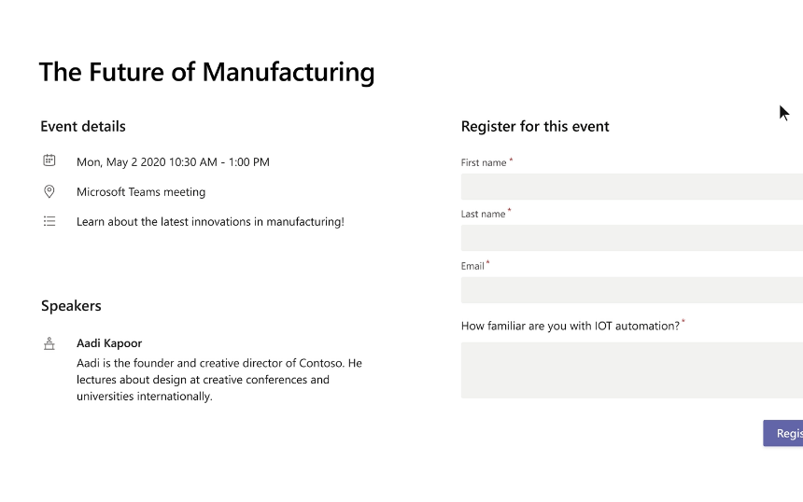
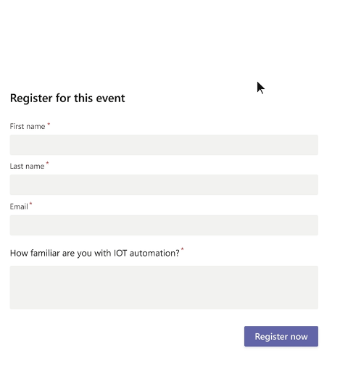
Registration and Confirmation
Create an attendee registration page for any event to better manage attendance before and after the engagement.
Add custom questions to help gather additional information at the point of registration.
And following registration, attendees receive an email confirmation with calendar invite.
Release = H1 CY2021
Contoso Presents: The Future of Design

Slide 4
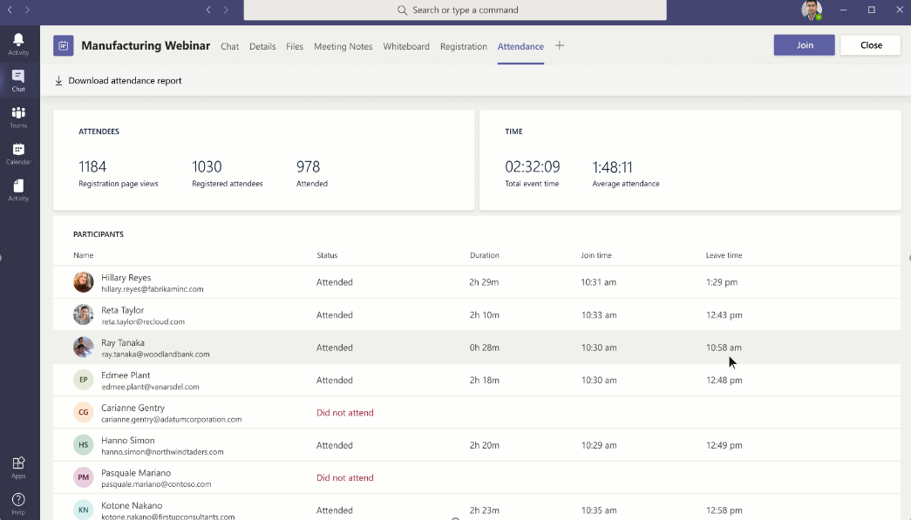
Attendee Reporting
Presenters and organizers can easily view attendance and interactions during the event
And leverage scheduling and reporting APIs to share data into marketing automation and CRM tools.
Download registration reports and leverage API for 3P integrations into CRM and Marketing Automation apps
Release = H1 CY2021

Slide 5
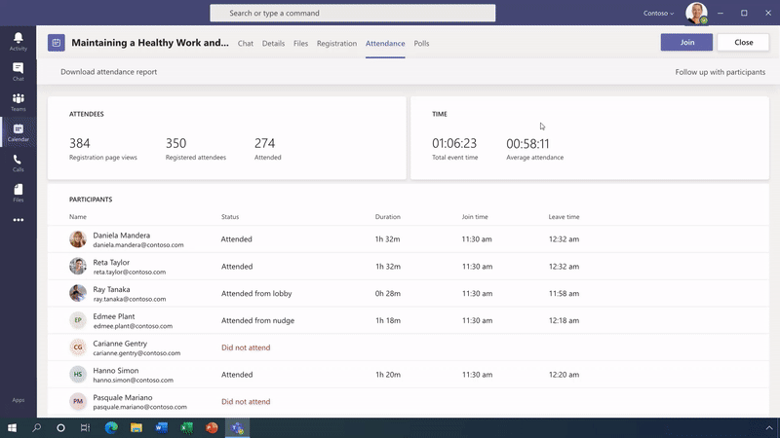
Dynamics 365 Event Experience
Today: Dynamics 365 Marketing campaigns using the robust event capabilities in Teams and the attendee management experiences from Dynamics 365 Marketing.
Coming soon, following a Teams webinar, customers can connect to Dynamics 365 Marketing to deliver a range of marketing activities, from basic follow-up communications to more sophisticated relationship marketing campaigns.
Release = H1 CY2021

Slide 6
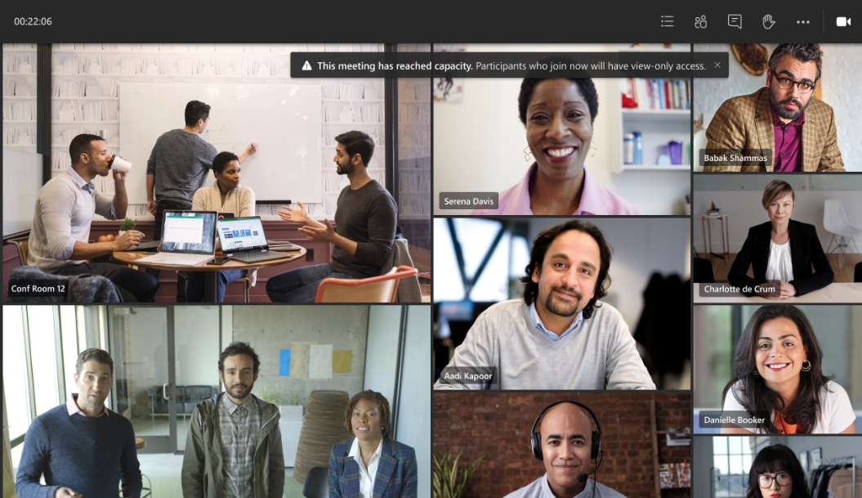
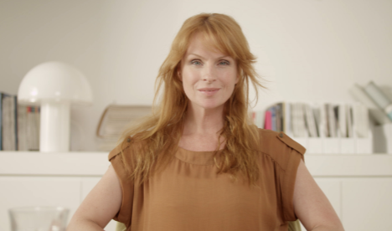
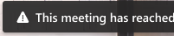

View-Only Experience “Overflow”
Host 1,000 attendees with full interactivity, including polls, video sharing and reactions
Broadcast up to 10,000 attendees with a view-only experience to minimize interruptions. During this time of increased remote work, take advantage of even larger 20,000-person broadcasts through the end of this year
Release = H1 CY2021
Conf Room 11
1,000-person interactive meeting
10,000-person view-only broadcast

Slide 7

Webinar Capabilities Roadmap
Generally Available
Q1 CY21 Roadmap
Mute all attendees
Select the options to join all attendees on mute, without the ability for them to unmute
1,000-person events with app sharing, polling, & reactions
Hold interactive meetings for up to 1,000 attendees
20,000-person view-only broadcasts
View-only meetings experience for up to 20,000 attendees, limit returned to 10,000 on December 31 2021
Add polls to meetings
Add a Forms tab to any meeting to share real-time polls and surveys
Registration and email
Out of the box attendee registration page and email confirmation
Presenter layouts & speaker spotlight
Presenters use custom content and video views to enhance attendee experiences
PowerPoint Integration
Use presenter view to see notes, slides and your audience. Attendees can manage slides to follow along at their own pace.
Host controls: safety, security & moderation
Controls for meeting hosts to remove people from meetings, disable chat, enforce mute all
Attendee reporting
Download reports to understand who joined, and how long they attended
Raise hand and reactions
Attendees can request to speak and share live emojis during presentations

Slide 8
Feature comparison for Meetings and Live Events
Features | Teams Meetings | Teams Live Events
Attendee limits | 1,000 interactive / 20,000 view-only (Q1 CY21) | 20,000* *10,000 beginning June 30, 2021
Concurrency | NA | 50
Hide participant list | Q1 CY21 | a
Real Time Captions | For up to 1,000 attendees | a
All attendee mute | a | a
Q&A | a Q1 CY21 | a
Registration | a Q1 CY21 | r
Advanced monitoring for admin and presenters | a Q2 CY21 | r
Scheduling and reporting APIs | a Q2 CY21 | r
Attendee reporting | a Q1 CY21 | r
Attendees engagement dashboard | a Q2 CY21 | r
Custom content layouts | a Q1 CY21 | r
View in yammer | a H2 CY21 | a
Producer UX with Queue | a H1 CY21 | a
Production with RTMP | a H1 CY21 | a
Assign roles for producers and attendees | a H1 CY21 | a

Slide 9
Licensing for Webinars and Live Events
Webinar capabilities are included:
Enterprise E3
Enterprise E5
Education A3
Education A5
Business Standard* (300-person limit)
Business Premium* (300-person limit)
Live Events capabilities are included:
Enterprise E1
Enterprise E3
Enterprise E5
Education A3
Education A5
*1,000-person meetings and 20,000-person view-only broadcasts are not included in the SMB plans

